Slide 1

Python Data Structure

Slide 2
INDEX
Introduction
Sequences
Creating Sequences
Using Lists and Tuples
  Using Lists
  Using Tuples
  Sequence Unpacking
  Sequence Slicing
Dictionaries
List and Dictionary Methods
Sorting and Searching Lists
Multiple-Subscripted Sequences

Slide 3
INTRODUCTION
Data structures
  Structures that hold and organize information
Sequences
  Also know as arrays in other languages
  Store related data types
  3 types
    Strings
    Lists
    Tuples
Mappings
  In most languages called hashes or associative arrays
  Dictionaries are the only python mapping container

Slide 4
SEQUENCE
Sequence
  Series of items that are often related
  Strings are sequences in Python
  A sequence is returned by the range function
  Elements
    The individual items in each sequence
      Referred to by subscripts
    The first is always zero
    Obtain one by using sequenceName[ subscript ]
    Can also be referred to negatively
      -1 would be the last element of the sequence

Slide 5
SEQUENCE
c[ 0 ]
-45
c[ -12 ]
c[ 1 ]
6
c[ -11 ]
Name sequence (c)
c[ 2 ]
0
c[ -10 ]
c[ 3 ]
72
c[ -9 ]
c[ 4 ]
1543
c[ -8]
c[ 5 ]
-89
c[- 7 ]
c[ 6 ]
0
c[ -6 ]
c[ 7 ]
62
c[ -5 ]
c[ 8]
-3
c[ -4 ]
Position number of the element within sequence c
c[ 9 ]
1
c[- 3 ]
c[ 10 ]
6453
c[ -2 ]
c[ 11 ]
-78
c[ -1 ]

Slide 6
CREATING SEQUENCE
  Strings
    Use quotes
    string1 = ""
  Lists
    Use brackets
    Separate multiple items with a comma
    list1 = []
  Tuples
    Use parenthesis
    Separate multiple items with a comma
    tuple = ()
    singleton = 1, - this is a one element tuple or a singleton

Slide 7
LIST
Lists
  Not restricted to values of the same type
    Programmers use lists to hold data that is of the same type
  The length is not usually predetermined and can vary throughout the program
  Accessing elements out of range
    Python exits and an out of range error is displayed
Differences
  Tuples and lists can both contain the same data
  For practical purposes though each is used to hold different types of items

Slide 8
SAMPLE PROGRAMS
1 # Creating, accessing and changing a list.
2
3 aList = [] # create empty list
4
5 # add values to list
6 for number in range( 1, 11 ):
7 aList += [ number ]
8
9 print "The value of aList is:", aList
10
11 # access list values by iteration
12 for item in aList:
13 print item,
14
15 # access list values by index
16 print “Accessing values by index:"
17 for i in range( len( aList ) ):
18 print "%9d %7d" % ( i, aList[ i ] )
19
20 # modify list
21 aList[ 0 ] = -100
22 print "Value of aList after modification:", aList
Adds the values 1 to 10 to the list
Prints the list, both all at once and one at a time
Prints the list in comparison to its subscripts
Sets the value of the first item to -100

Slide 9
SAMPLE PROGRAMS
The value of aList is: [1, 2, 3, 4, 5, 6, 7, 8, 9, 10]
Accessing values by index:
Subscript Value
0 1
1 2
2 3
3 4
4 5
5 6
6 7
7 8
8 9
9 10
Value of aList before modification: [1, 2, 3, 4, 5, 6, 7, 8, 9, 10]

Slide 10
TUPLE
Tuples
  Used to contain data that is related but not necessarily of the same type
    Each data item represents a unique piece of the overall portion
      In this case tuples are usually not not iterated though
      The needed data is accessed before hand
    A person’s name, age and birth date
    Again this is not required but is a general rule

Slide 11
DICTIONARIES
Dictionaries
  Mapping constructs consisting of key-value pairs
    Referred to as hashes in other languages
  Unordered collection of references
  Each value is referenced though key in the pair
  Curley braces ({}) are used to create a dictionary
  When entering values
    Use { key1:value1, … }
  Keys must be immutable values such as strings, numbers and tuples
  Values can be of any Python data type

Slide 12
SAMPLE PROGRAMS
1 # Fig. 5.09: fig05_09.py
2 # Creating, accessing and modifying a dictionary.
3
4 # create and print an empty dictionary
5 emptyDictionary = {}
6 print "The value of emptyDictionary is:", emptyDictionary
7
8 # create and print a dictionary with initial values
9 grades = { "John": 87, "Steve": 76, "Laura": 92, "Edwin": 89 }
10 print "\nAll grades:", grades
11
12 # access and modify an existing dictionary
13 print "\nSteve's current grade:", grades[ "Steve" ]
14 grades[ "Steve" ] = 90
15 print "Steve's new grade:", grades[ "Steve" ]
16
17 # add to an existing dictionary
18 grades[ "Michael" ] = 93
19 print "\nDictionary grades after modification:"
20 print grades
21
22 # delete entry from dictionary
23 del grades[ "John" ]
24 print "\nDictionary grades after deletion:"
25 print grades
Creates an empty dictionary
Creates a grades dictionary using names as the key and their grade as the value
Alters and displays the new grade for Steve
Adds a new name to the grades dictionary
Removes the name john from the dictionary with the del keyword

Slide 13
SAMPLE PROGRAMS
The value of emptyDictionary is: {}
All grades: {'Edwin': 89, 'John': 87, 'Steve': 76, 'Laura': 92}
Steve's current grade: 76
Steve's new grade: 90
Dictionary grades after modification:
{'Edwin': 89, 'Michael': 93, 'John': 87, 'Steve': 90, 'Laura': 92}
Dictionary grades after deletion:
{'Edwin': 89, 'Michael': 93, 'Steve': 90, 'Laura': 92}

Slide 14
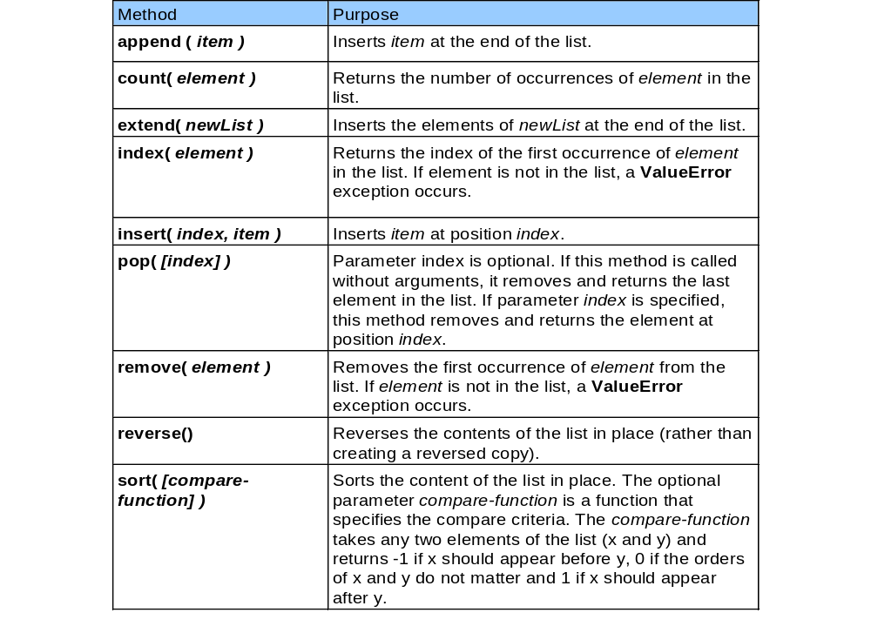
LIST METHODS

Slide 15
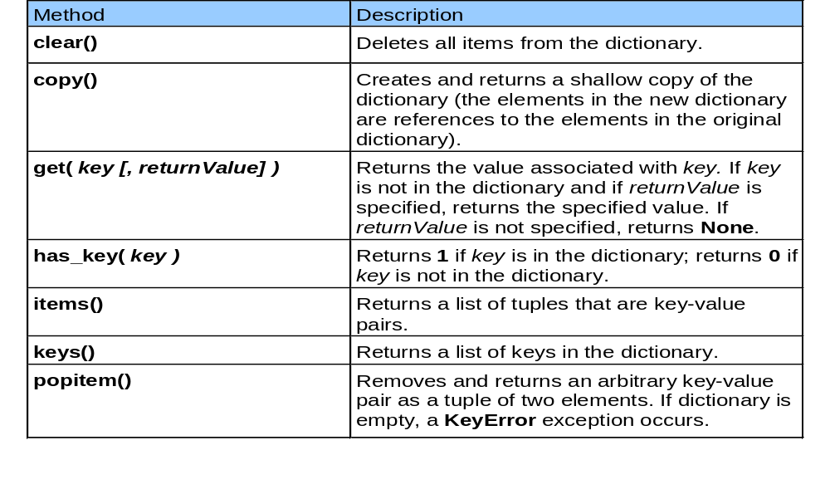
DICTIONARY METHODS

Slide 16
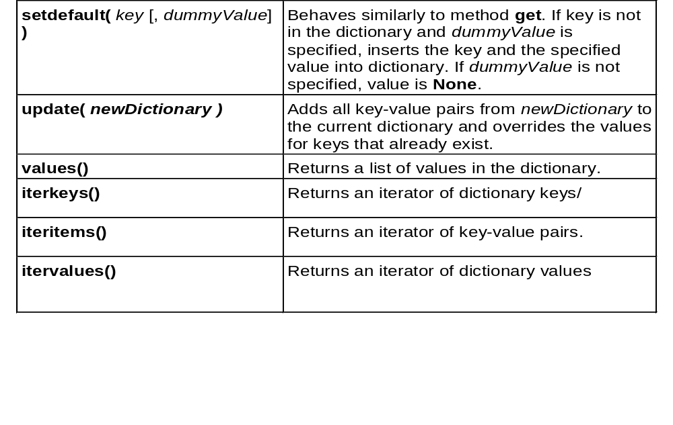
DICTIONARY METHODS

Slide 17
SORTING AND SEARCHING A LIST
Sorting a list
  Use the sort method
Searching a list
  Use the index method

Slide 18
SORTING A LIST
1 # Fig: sorting_list.py
2 # Sorting a list.
3
4 aList = [ 2, 6, 4, 8, 10, 12, 89, 68, 45, 37 ]
5
6 print "Data items in original order"
7
8 for item in aList:
9 print item,
10
11 aList.sort()
12
13 print "\n\nData items after sorting"
14
15 for item in aList:
16 print item,
17
18 print
Displays the unorganized list
The sort method is used to order the numbers in ascending order
Displays the sorted list
Data items in original order
2 6 4 8 10 12 89 68 45 37
Data items after sorting
2 4 6 8 10 12 37 45 68 89

Slide 19
SEARCH IN A LIST
1 # Fig. 5.18: fig05_18.py
2 # Searching a list for an integer.
3
4 # Create a list of even integers 0 to 198
5 aList = range( 0, 199, 2 )
6
7 searchKey = int( raw_input( "Enter integer search key: " ) )
8
9 if searchKey in aList:
10 print "Found at index:", aList.index( searchKey )
11 else:
12 print "Value not found"
Creates a list containing the even numbers from 0 to 200
The index method is used to find an item in the list and return the index of that item
Enter integer search key: 36
Found at index: 18
Enter integer search key: 37
Value not found

Slide 20
MULTIPLE SCRIPTED SEQUENCES
1 # Fig. 5.20: fig05_20.py
2 # Making tables using lists of lists and tuples of tuples.
3
4 table1 = [ [ 1, 2, 3 ], [ 4, 5, 6 ] ]
5 table2 = ( ( 1, 2 ), ( 3, ), ( 4, 5, 6 ) )
6
7 print "Values in table1 by row are"
8
9 for row in table1:
10
11 for item in row:
12 print item,
13
14 print
15
16 print "\nValues in table2 by row are"
17
18 for row in table2:
19
20 for item in row:
21 print item,
22
23 print
This list has two rows
This tuple has three rows
A nested for loop is needed to display all of the items in the list

Slide 21
MULTIPLE SCRIPTED SEQUENCES
Values in table1 by row are
1 2 3
4 5 6
Values in table2 by row are
1 2
3
4 5 6

